Slide 1
Safe Physics-Informed Learning in Dynamics and Control
Ján Drgoňa
Associate Professor Civil and Systems Engineering Department The Ralph O'Connor Sustainable Energy Institute

Slide 2
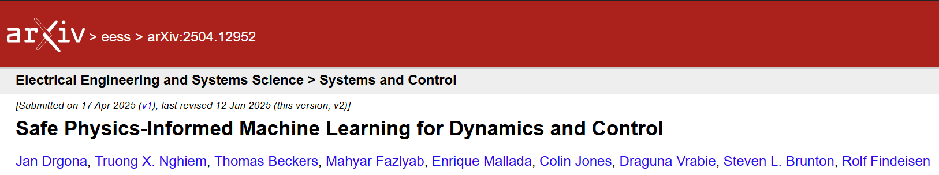
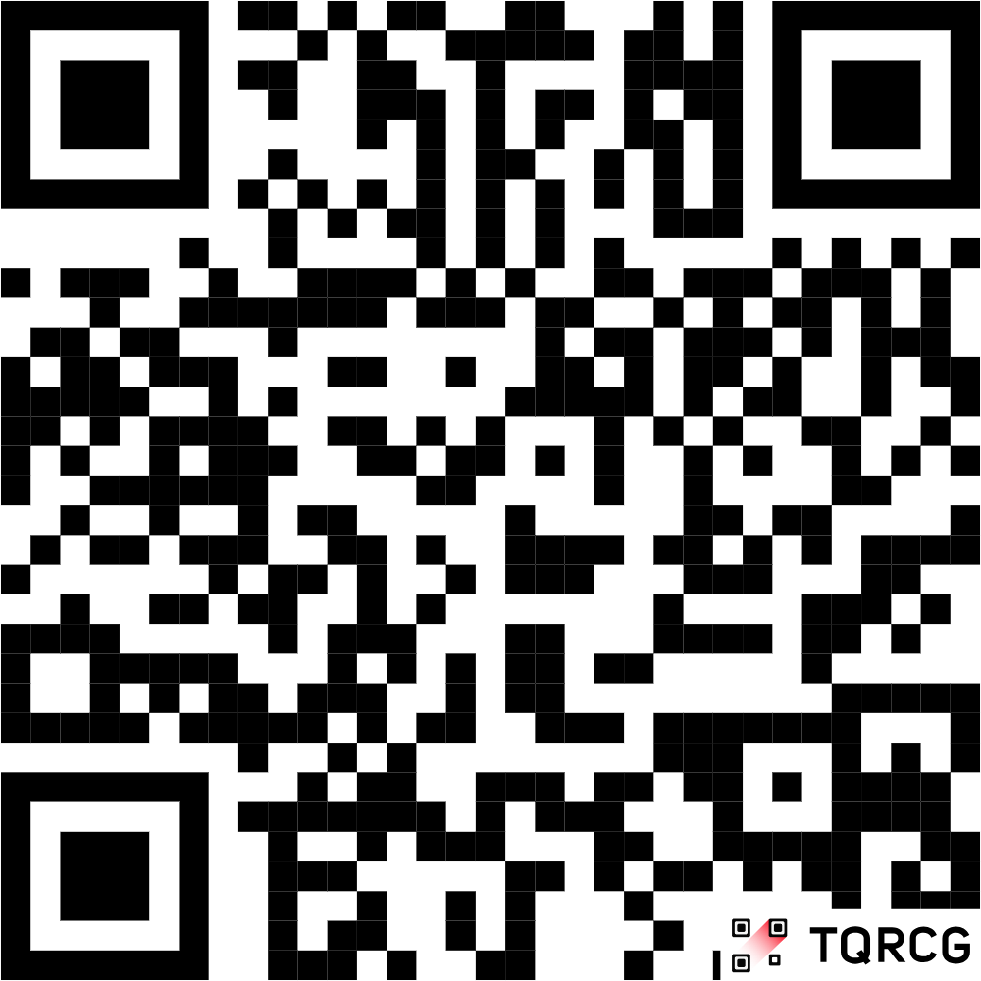
II. SAFE LEARNING FOR DYNAMICS
Stability Guarantees
Constraints Satisfaction
Uncertainty Quantification
III. SAFE LEARNING FOR CONTROL
Learning-based Model Predictive Control and Predictive Safety Filters
Control Barrier and Control Lyapunov Functions
IV. SAFETY VERIFICATION METHODS
Reachability Analysis Methods
Constrained Optimization-based Methods
Simulation and Sampling-based Methods
V. CHALLENGES AND OPPORTUNITIES
arXiv:2504.12952

Slide 3

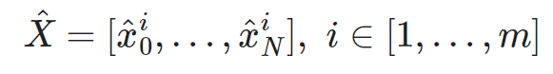
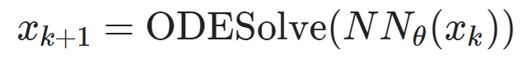
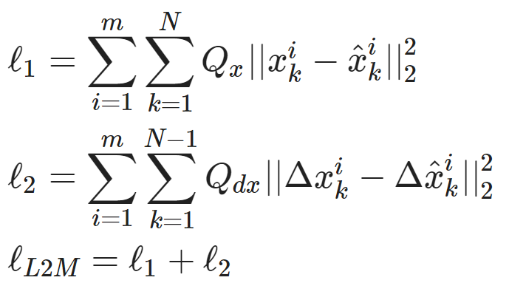
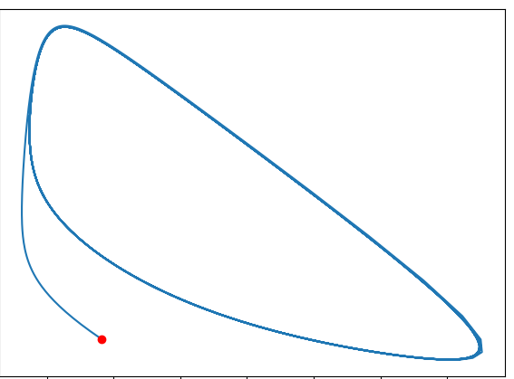
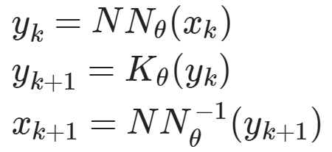
Learning to Model (L2M) Dynamical Systems
Dataset: batched time-series of states and inputs.
Architecture: differentiable ODE solver with neural network model.
Loss function: trajectory matching, regularizations, and constraints penalties.
Architecture: Koopman operator with neural network basis functions.
https://github.com/pnnl/neuromancer/blob/master/examples/ODEs/Part_1_NODE.ipynb https://github.com/pnnl/neuromancer/blob/master/examples/ODEs/Part_7_DeepKoopman.ipynb
R. T. Q. Chen, et al., Neural Ordinary Differential Equations, 2019
B. Lusch, et al., Deep learning for universal linear embeddings of nonlinear dynamics, 2018

Slide 4
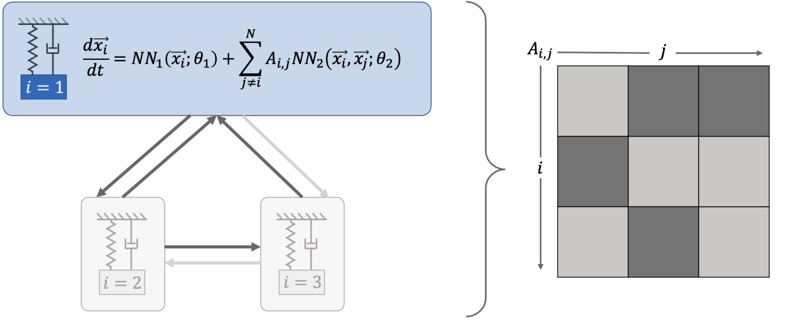
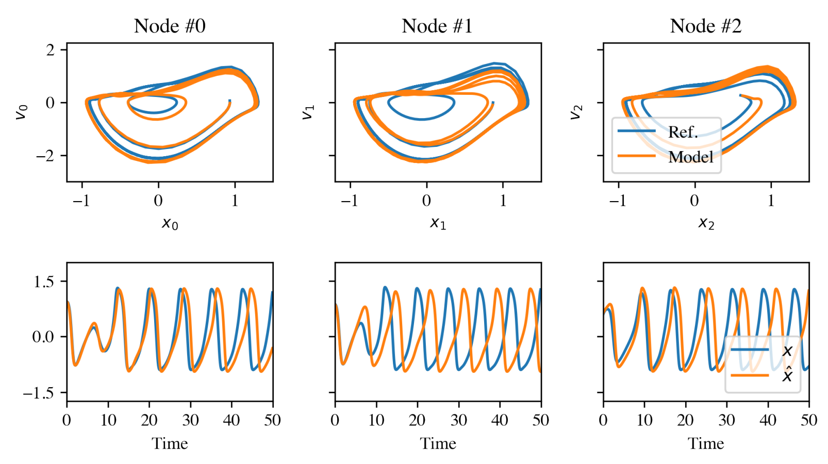
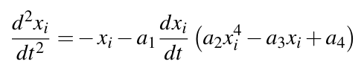
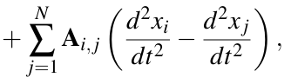
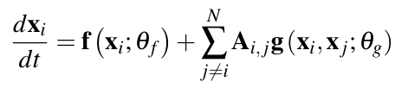
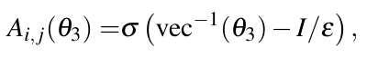
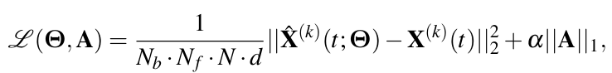
Learning Networked Dynamical Systems via Universal Differential Equations
Network of unknown oscillators
Coupling adjacency
Ground truth system:
Generalization of learned dynamics on never-seen network topology.
Learned dynamics qualitatively retains the attractor shape even on out of distribution data.
Networked NODE:
Sparsity-promoting loss:
James Koch, Zhao Chen, Aaron Tuor, Jan Drgona, Draguna Vrabie, Structural Inference of Networked Dynamical Systems with Universal Differential Equations, Chaos: An interdisciplinary Journal of Nonlinear Science, doi.org/10.1063/5.0109093, 2023

Slide 5
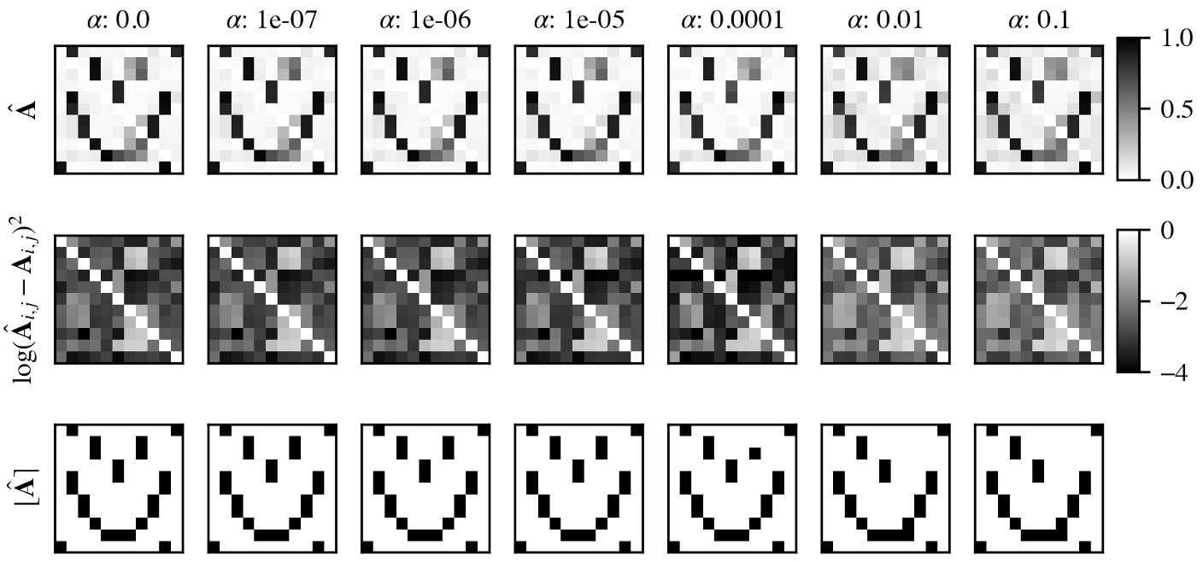
Learning Networked Dynamical Systems via Universal Differential Equations
Learning adjacency matrix of the unknown network ODE system.
James Koch, Zhao Chen, Aaron Tuor, Jan Drgona, Draguna Vrabie, Structural Inference of Networked Dynamical Systems with Universal Differential Equations, Chaos: An interdisciplinary Journal of Nonlinear Science, doi.org/10.1063/5.0109093, 2023

Slide 6
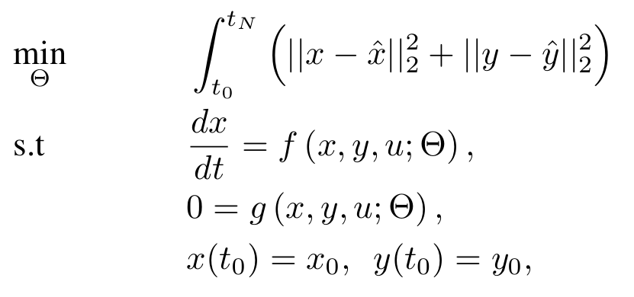
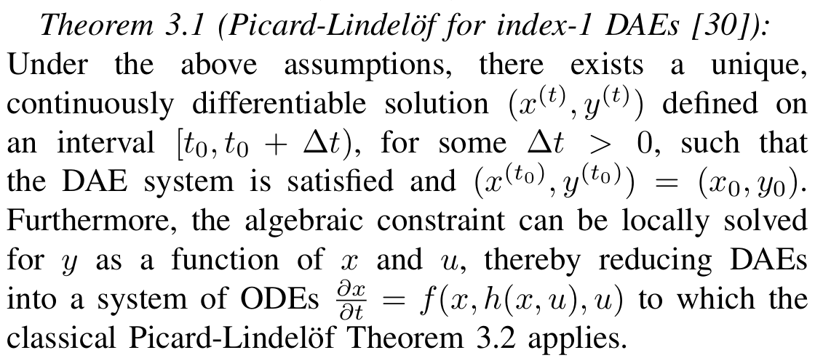
Learning Neural Differential Algebraic Equations via Operator Splitting
DAE parameter estimation problem:
Assumptions:
𝑓 is continuous in both 𝑡 and 𝑥
𝑓 is Lipschitz continuous in 𝑥 on some neighborhood of initial conditions
The Picard–Lindelöf theorem (also called the Cauchy–Lipschitz theorem) gives sufficient conditions under which an initial value problem (IVP) for an ordinary differential equation (ODE) has a unique solution.
[30] K. E. Brenan, S. L. Campbell, and L. R. Petzold, Numerical Solution of Initial-Value Problems in Differential-Algebraic Equations. SIAM, 1996.
https://github.com/pnnl/NeuralDAEs
J. Koch, M. Shapiro, H. Sharma, D. Vrabie, J. Drgona, Learning Neural Differential Algebraic Equations via Operator Splitting, arXiv:2403.12938, 2024.

Slide 7
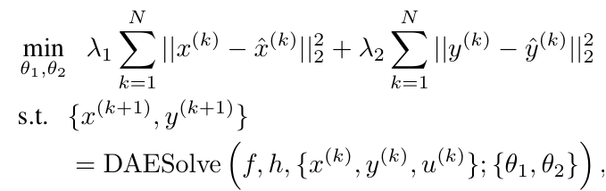
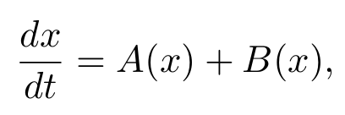
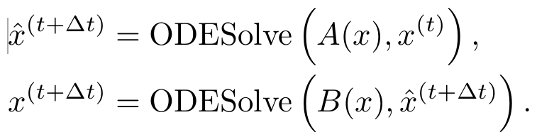
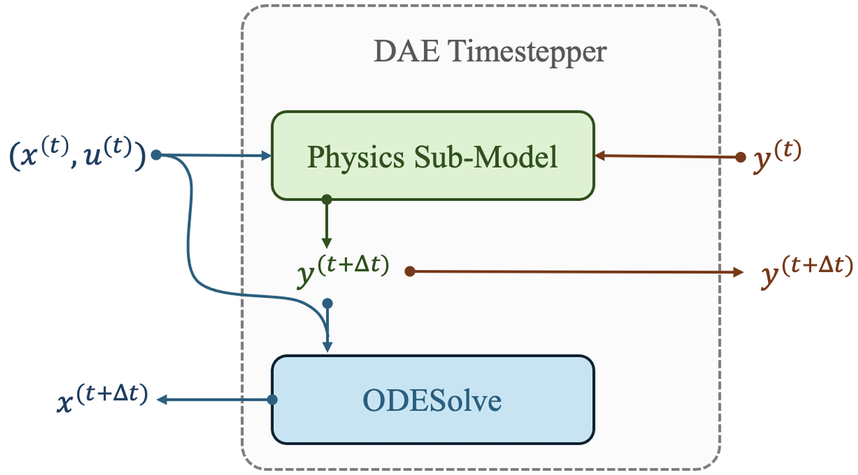
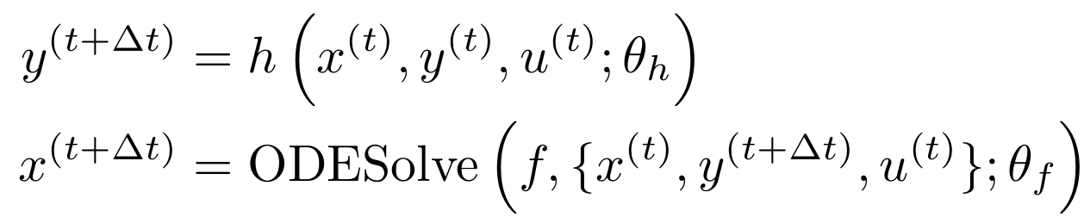
Learning Neural Differential Algebraic Equations via Operator Splitting
Our neural DAE time stepper architecture is inspired by operator splitting methods for ODEs:
Neural DAE learning problem:
Lie-Trotter splitting scheme for ODEs:
Operator splitting for DAEs:
https://github.com/pnnl/NeuralDAEs
J. Koch, M. Shapiro, H. Sharma, D. Vrabie, J. Drgona, Learning Neural Differential Algebraic Equations via Operator Splitting, arXiv:2403.12938, 2024.

Slide 8
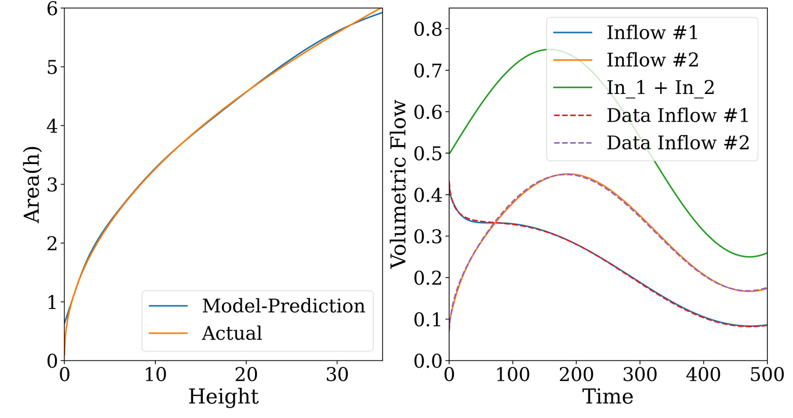
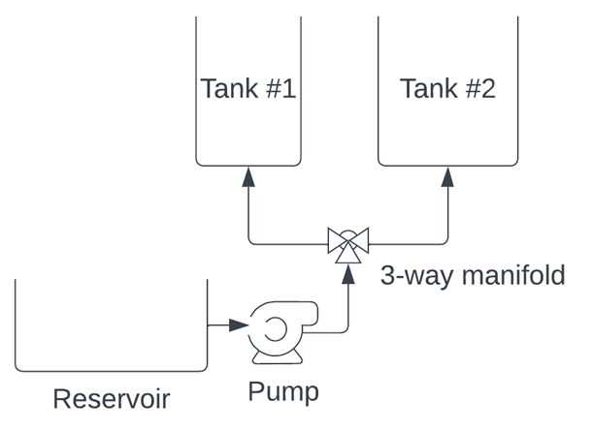
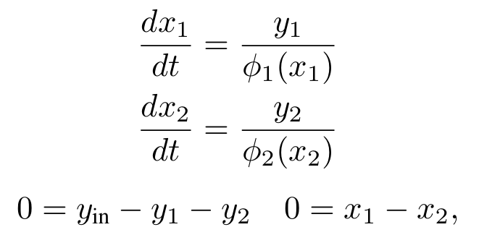
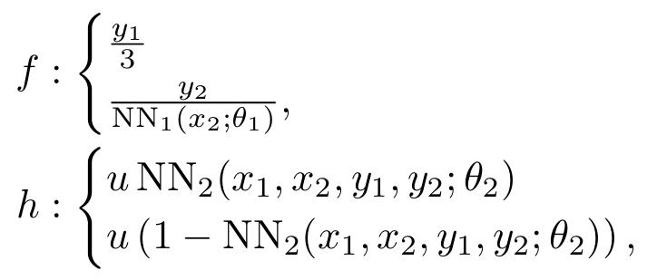
Learning Neural Differential Algebraic Equations via Operator Splitting
Case study: coupled tank modeling
DAE with unknown components:
Neural DAE:
Inverse modeling, robustness to noise and, out of distribution generalization.
https://github.com/pnnl/NeuralDAEs
J. Koch, M. Shapiro, H. Sharma, D. Vrabie, J. Drgona, Learning Neural Differential Algebraic Equations via Operator Splitting, arXiv:2403.12938, 2024.

Slide 9
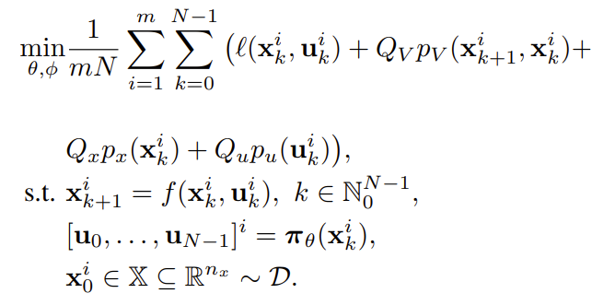
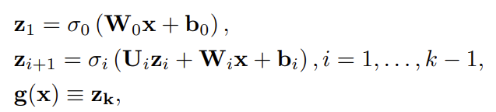
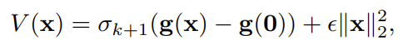
Learning Neural Lyapunov Functions from Time-series Data
We aim to find neural Lyapunov function candidate satisfying the following conditions:
Learning problem formulation for joint learning of neural Lyapunov functions and control policies via Differentiable Predictive Control (DPC)
Neural Lyapunov function candidate via input-convex neural network (ICNN) architecture
Physics-informed loss function with discrete-time Lyapunov penalty:
https://github.com/pnnl/neuromancer/blob/master/examples/control/Part_5_neural_Lyapunov.ipynb https://github.com/pnnl/neuromancer/tree/Lyapunov_DPC
Gaurav Manek, J. Zico Kolter, Learning Stable Deep Dynamics Models, NeurIPS 2019
S. Mukherjee, J. Drgoňa, A. Tuor, M. Halappanavar, D. Vrabie, Neural Lyapunov Differentiable Predictive Control, CDC, 2022

Slide 10

NeuroMANCER Scientific Machine Learning Library
Open-source library in PyTorch
Physics-informed Neural Networks
Learning to optimize
Neural differential equations
Learning to control
github.com/pnnl/neuromancer

Slide 11

Summary
Challenges
Uncertainty Quantification (UQ)
Conservatism vs. performance tradeoff
Safe exploration in learning-based control
Scalability of guarantees and verification methods
Opportunities
Integrated UQ and safety filters
Differentiable control theory-inspired learning architectures
Sample efficient safe learning-based control
Benchmarking and software tools
Follow up
TuC04 Tutorial Session, Governor's Sq. 15, 15:30-17:00,
drgona.github.io jdrgona1@jh.edu
github.com/pnnl/neuromancer

Slide 12


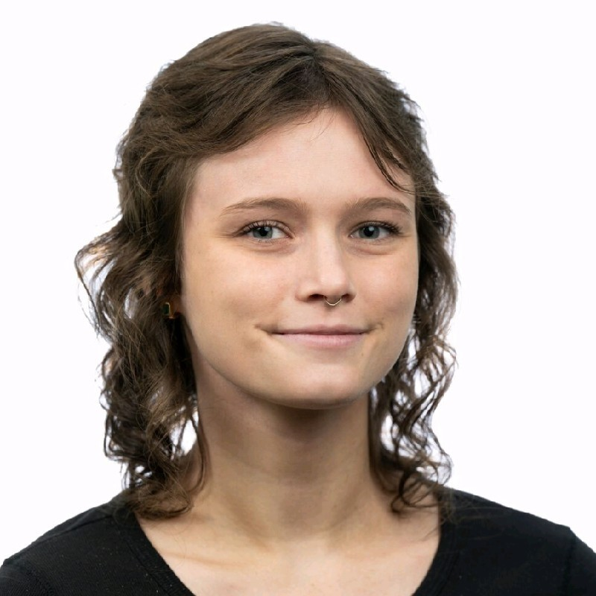

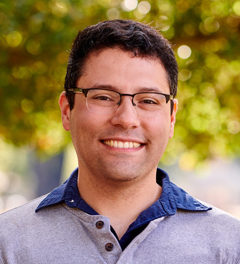



NeuroMANCER Team
Aaron Tuor
James Koch
Madelyn Shapiro
Rahul
Birmiwal
Bruno
Jacob
Draguna
Vrabie

